Slide 1
Project-age-estimation-pytorch

Slide 2
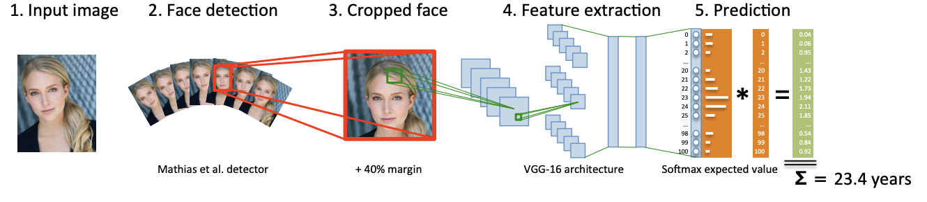
Dex method

Slide 3
Motivation choice of VGG model
The choice is motivated by :
the deep but manageable architecture
the impressive results achieved using VGG-16 on the ImageNet challenge
the fact that as in our case the VGG-16 architecture starts from an input image of medium resolution (256 × 256) and that pretrained models for classification are publicly available allowing warm starts for training

Slide 4
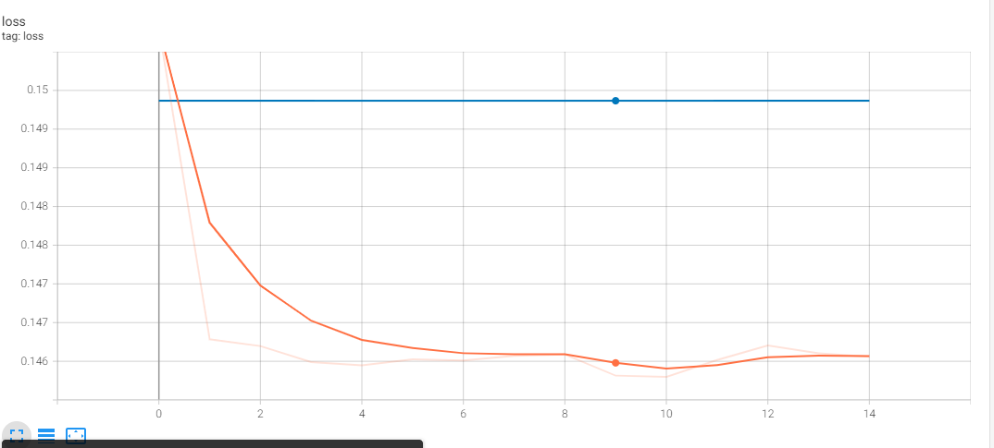
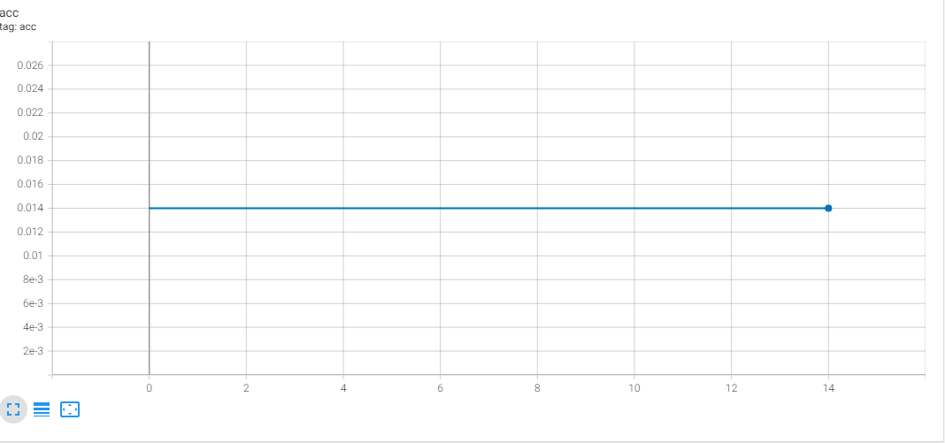
Probleme of VGG model
the mae does not decrease too much :
• accuracy stagnates and the loss rapidly stagnating :

Slide 5
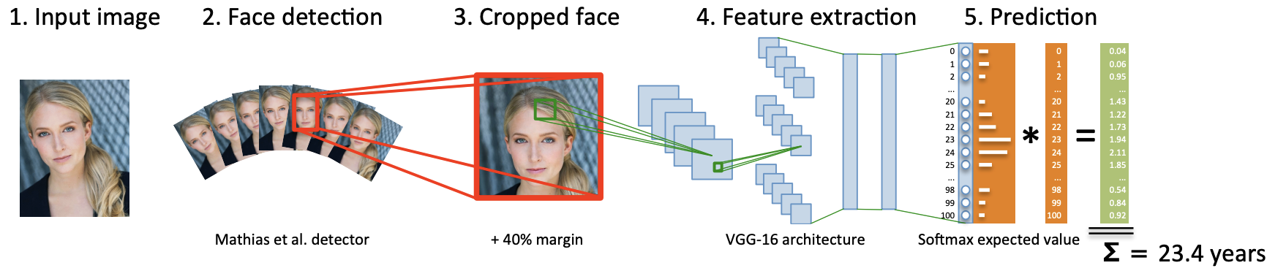

Model
Resnext architecture

Slide 6
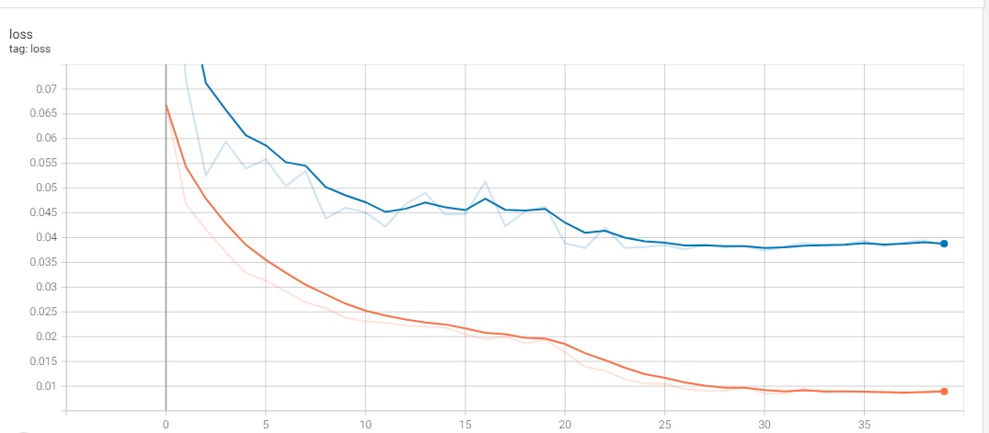
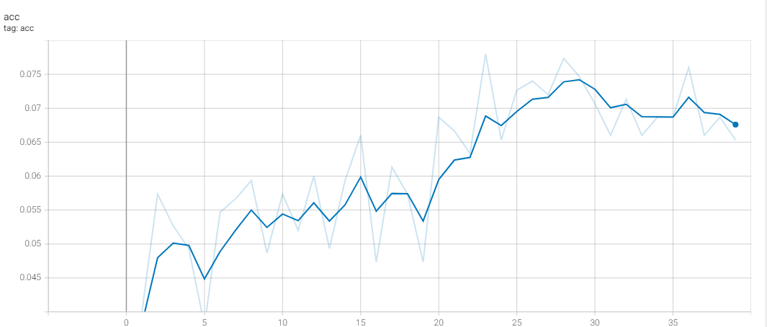
Results

Slide 7
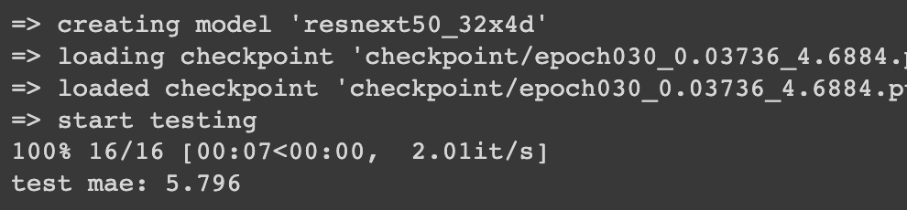
Results

Slide 8
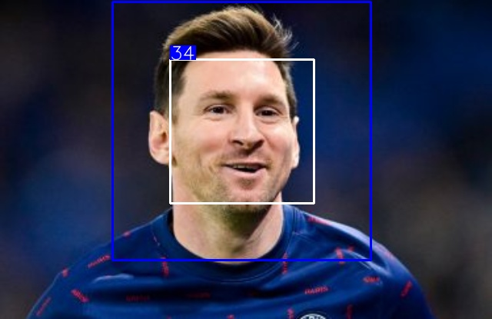
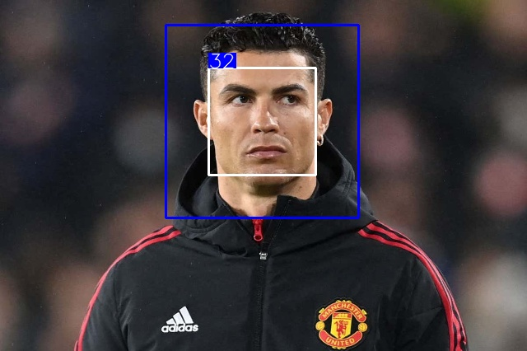
Example

